Slide 1


SMART INDIA HACKATHON 2025
TITLE PAGE
Problem Statement ID – 25115
Problem Statement Title- Student Innovation: Swadeshi for Atmanirbhar Bharat - Miscellaneous
Theme- Miscellaneous
PS Category- Hardware
Team ID-
Team Name - CLOVER

Slide 2
HUMANOID CUSTOMER REPRESENTATIVE
CLOVER
PROBLEM ADDRESSED & PROPOSED SOLUTION
In high-traffic service sectors like hospitals, banks, and campus offices, users often face delays due to staff unavailability or overload. Non-tech users struggle with digital systems, leading to confusion, long queues, and poor service experience.
SOLUTION
A Humanoid Customer Representative—a semi-autonomous assistant combining voice interaction, touch interface, and physical presence. It handles routine queries, guides users, and integrates with institutional databases for real-time, secure responses.
Voice + Touch Interface for accessibility
Sensor-triggered activation for walk-up interaction
Multilingual-ready architecture
Modular shell with screen, mic, speaker
AI backend with pre-fed FAQs + server integration
INNOVATION & UNIQUENESS
PHYSICAL presence builds trust, especially for non-tech users
Low-cost, scalable build using repurposed components
Hybrid design: software intelligence + hardware interface
Privacy-first architecture with local processing and secure data fetch
Let me know when you're ready to move to Slide 2: Technical Approach. I’ll keep it equally compact and impactful.

Slide 3
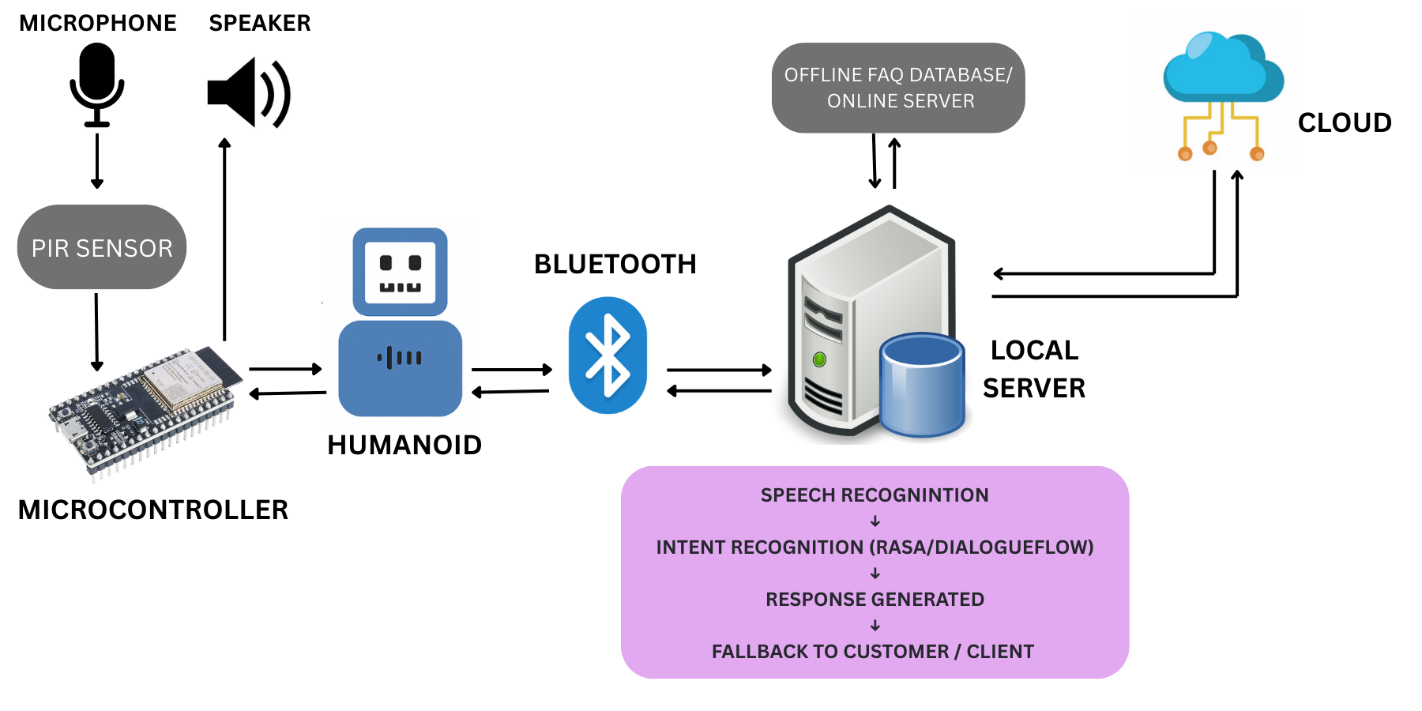


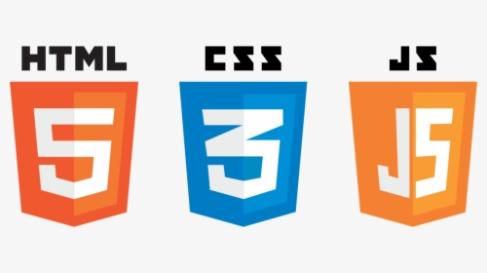







TECHNICAL APPROACH
CLOVER
TECH ARCHITECTURE OVERVIEW
SOFTWARE
Python – backend logic & voice pipeline
JavaScript + HTML/CSS – interface, animated face, touch menu
Rasa / Dialogflow CX – conversational AI, intent handling
Vosk (offline STT) – speech recognition in regional languages
gTTS / pyttsx3 – text-to-speech
SQLite / Firebase – FAQ DB, logs, user interactions
REST API – secure integration with org servers
HARDWARE
Embedded board / PC
Digital screen > Mic + Speaker
Sensors (presence PIR / touch)
Wi-Fi & Bluetooth
SECURITY & PRIVACY
Local AI processing – minimizes data leakage
Role-based access – secure data fetch
Offline fallback – handles queries without internet
DIGITAL SCREEN
FLOW DIAGRAM

Slide 4

FEASIBILITY AND VIABILITY
CLOVER
FEASIBILITY ANALYSIS
Multi-Sector Ready: Deployable in hospitals, banks, and campuses with minimal reconfiguration.
Portable Power: Runs on compact 3.7V Li-Po battery ensuring uninterrupted service.
Offline Core: Essential functions operate locally, avoiding internet dependency.
IoT-Enabled: Presence detection sensor triggers instant, automatic activation.
Modular Interface: Dual support for touch and voice inputs for flexible user interaction.
Scalable Rollout: Can function with or without database access—serving as receptionist, guide, or query agent.
IMPLEMENTATION CHALLENGES
BATTERY life sustainability.
Accurate speech recognition in noisy settings.
Comfort level of first-time/non-tech users.
Durability of the physical hardware in public spaces.
MITIGATION STRATEGIES
Optimized low-power circuitry and smart sleep modes.
Noise suppression algorithms for speech clarity.
Guided onboarding with multilingual prompts and visual cues.
Maintenance workflows via student volunteers or staff for routine upkeep.

Slide 5
IMPACT AND BENEFITS
CLOVER
IMPACT
Inclusive Access: Intuitive interface for non-technical users, minimizing app/digital literacy barriers.
Reduced Wait Times: Instant guidance for bank customers, hospital visitors, and campus users.
Staff Efficiency: Automates repetitive queries, freeing personnel for priority tasks.
High-Footfall Service Enhancement: Acts as a first-point assistant in crowded counters.
Accessibility: Supports elderly, rural populations, and users with limited tech exposure.
BENEFITS
Time Efficiency: Speeds up query resolution and navigation guidance.
Cost Savings: Reduces need for additional staff for routine tasks.
Scalable Deployment: Easily replicable across sectors with minimal configuration.
Trust & Comfort: Physical presence + voice interaction enhances user confidence.
Offline Reliability: Core functions operate without internet.
Modular Customization: Interface, language, and responses adaptable per deployment.
FUTURE SCOPE
Multilingual Expansion: Regional language support for broader inclusivity.
Biometric Integration: Optional user verification for personalized responses.
Gesture & Emotion Recognition: Non-verbal interaction and adaptive responses.
Sector-Specific Modules: Tailored roles for hospitals, banks, and colleges.
Data Analytics: Query logging for operational insights and continuous improvement.

Slide 6
RESEARCH AND REFERENCES
CLOVER
TOPIC | SOURCE TITLE | LINK
Conversational AI Framework | Rasa vs Dialogflow Comparison | https://botpenguin.com/blogs/rasa-vs-dialogflow
Offline Speech Recognition | VOSK Speech Recognition Toolkit | https://alphacephei.com/vosk
IoT Sensor Integration | PIR Sensor with ESP8266 & Arduino IoT Cloud | https://www.electroniclinic.com/pir-sensor-with-esp8266-nodemcu-and-arduino-iot-cloud
Modular Humanoid Design | Modularity in Humanoid Robot Design – DLR | https://elib.dlr.de/202909/1/wolf_modularity_copyright.pdf
Privacy-First AI Architecture | Privacy-First AI Architecture | https://macaron.im/privacy-first-ai-agent
Impact in Public Sector | Humanoid Robots in Government – Proven Robotics | provenrobotics.ai

